Slide 1
Whitewater Unified School District Supporting the Emotional Needs of our Students: A K-12 Perspective
Lanora Heim, Ph.D.
Director of Pupil Services

Slide 2
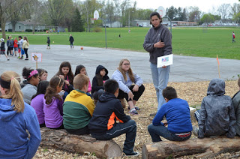
Whitewater Unified School District
Vision Every Graduate an Engaged Lifelong Learner
Mission
Whitewater Unified School District (WUSD), in collaboration with families and community, inspires students to achieve excellence in a safe, innovative educational environment.

Slide 3
Pair share: name everything that causes students trauma.

Slide 4
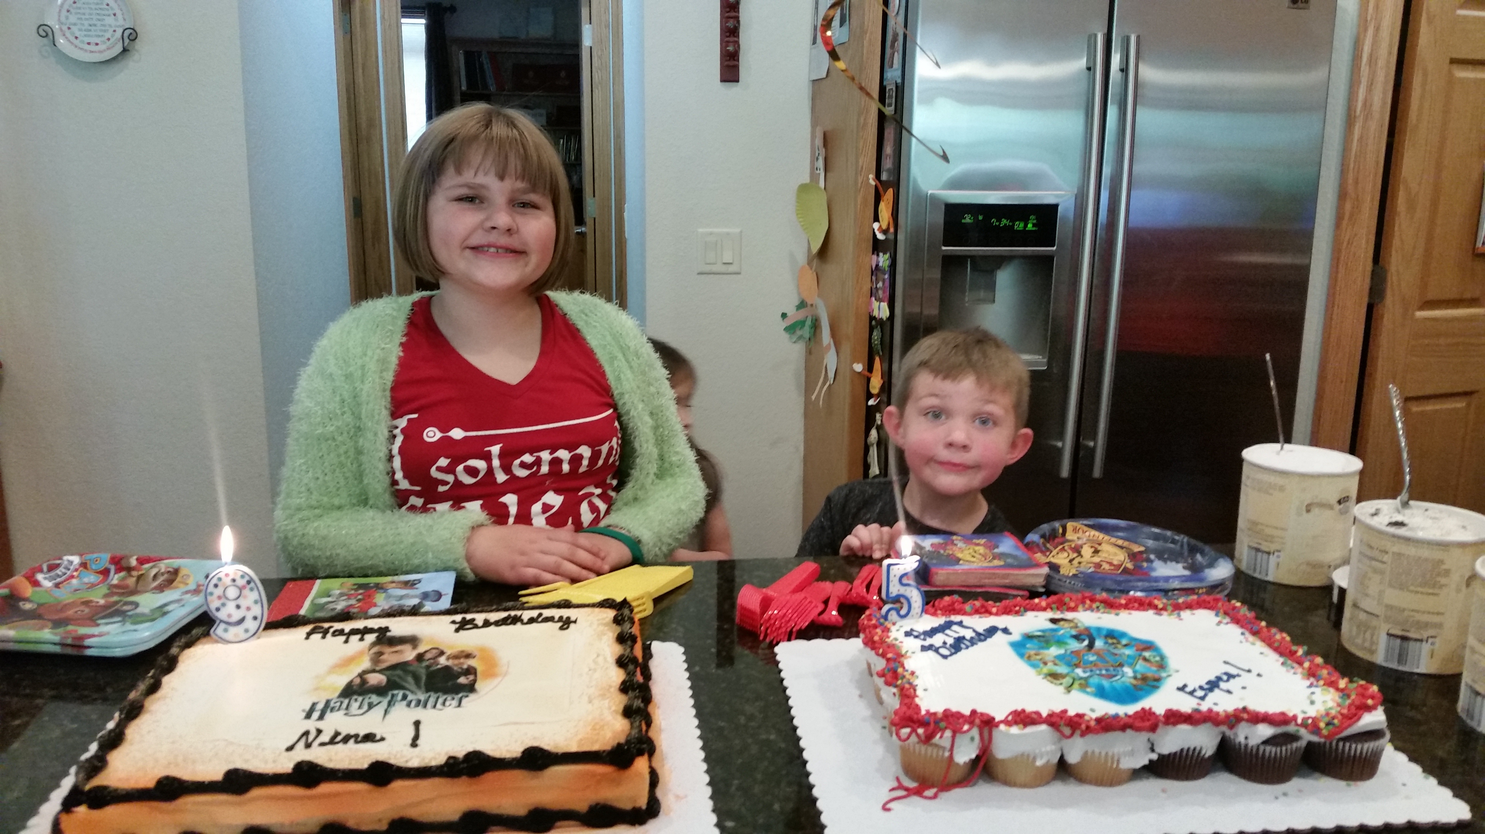

Slide 5
There are 775 children in WUSD that qualify for free/reduced lunch (not counting 4K and Early Childhood students who are not yet eligible).
This is comprised of:
55% of Lincoln
32% of Lakeview
54% of Washington
42% of Middle School
33% of High School

Slide 6
Homeless Students
In 2015-16 WUSD had 31 homeless students
In 2016-17 WUSD had 44 homeless students
In 2017-2018 WUSD had 67 homeless students
Foster Students
In 2016-17 WUSD had a total of 47 students placed in Foster type situations.
In 2017-2018 WUSD had a total 30

Slide 7
Family Emergency Fund: The fund spent a total of $2,201.70 during September in the following ways:
Rent assistance for a homeless family to secure housing (Garden Apartments)
Gas cards for a child to visit critically ill parent in the hospital
Assistance for a parent to get a driver’s license (so parent could drive to new job)
Food for a homeless family
Security Deposit (split with community organization) for homeless family to secure housing
Rent assistance (split with community organization) to prevent family from being evicted
Financial Assistance for a district family who took in another district student whose parent is too ill to care for him/her
Assistance to a family who had a death of one of the parents in the household
Transportation support for a student with medical needs to get to appointments
Household supplies for a single parent who lost job
Taxi Vouchers for families in need to access community appointments and school events

Slide 8
2017 YRBS data revealed
29% of students felt sad or hopeless almost everyday for a period of 2 weeks or more (exhibiting signs of depression)
The percentage of students who seriously considered attempting suicide in the past 12 months F = 23.4% M = 6.2%
Percentage of students who attempted suicide at least once in the past 12 months F = 6.9% M = 2.7%

Slide 9
WUSD GOAL
Create And Implement District Mental Health Programming that will support staff in addressing student mental health and trauma related needs.
Partnerships
Comprehensive Ongoing Professional Development
Policy
Direct Student Support

Slide 10
Create a Movement

Slide 11
Partnerships
Collaborating with Walworth, Jefferson and Rock Counties
Fort Health Care/Rogers Memorial Hospital
UW-Whitewater (Winther Counseling Lab)
Wisconsin Department of Public Instruction (mental health framework)
Community Partnerships (Civic Groups)
Area Law Enforcement and Crisis Response Teams

Slide 12
Comprehensive Ongoing Professional Development
County Supports
DPI Supports
Attendance at Monthly Pupil Service Team Meetings
Tier I, II, and III training with Jefferson County.
Mental Health First Aid Certification (Kim Propp)
Wisconsin Trauma Project with Walworth County
Mental Health Framework intensive training (building teams)
Trauma Modules
Endless Possibilities Conference (CESA #1)
Emotional Regulation Plans

Slide 13
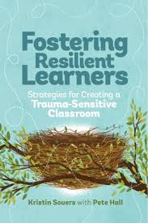
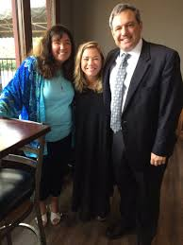
Fostering Resilient Learners: Strategies for Creating a Trauma-Sensitive Classroom by Kristen Souers
Book Study
Key Note Speaker

Slide 14
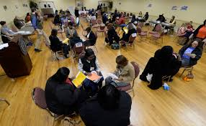
Poverty Simulation
Rock Valley Conference
All staff

Slide 15
Comprehensive Ongoing Professional Development
District Supports
November 10 PD
Non Violent Crisis Intervention Training
Two Half Days of Professional Development
Monthly Staff Meetings
Monthly Emails
Staff Wellness
Mindfullness/Brain Based Learning
DBT in Schools
The Effects of Trauma on the Brain
Heartmath Room
Incredible Years
DBT Tip Skills Room
Coping Cat Room
Mindfullness for MS, HS and Elem kids
Project Yes

Slide 16
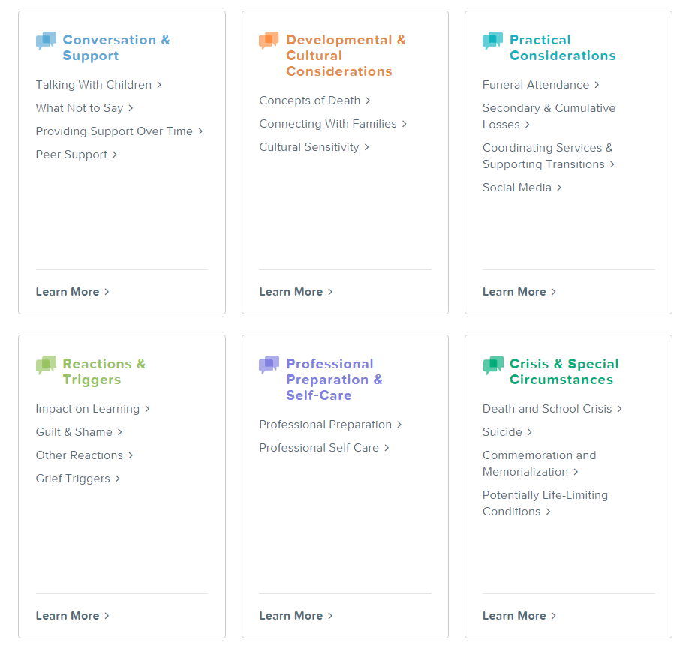
DOES YOUR SCHOOL NEED ADVICE NOW?
Contact us at 877-53-NCSCB
(877-536-2722) or info@grievingstudents.org

Slide 17
POLICY
Awareness
Roadmap
Examples: Suicide Intervention, Prevention, and Postvention, Code of Conduct

Slide 18
Direct Student Supports
YRBS
Collaborating with Walworth, Jefferson, and Rock Counties (training)
Developmental Guidance Lessons
Counseling in schools (add .5 social worker)
Winther Counseling Lab
Mental Health Counseling at WHS and WMS
Support groups at high school
Family Emergency Fund/Funds for Families
Lunch Buddies, Fast Friends (Mentors)
Securley: ⚠ Urgent: Potential Self Harm/Grief Activity Detected

Slide 19
Helping Kids Cope…Tips for Families and Educators (2015, National Association of School Psychologists, Bethesda, MD).
All Adults Should:
1. Model calm and control. Children take their emotional cues from the significant adults in their lives.
2. Reassure children they are safe and (if true) so are the important adults and other loved ones in their lives. Depending on the situation, point out factors that help ensure their immediate safety and that of their community.
3. Remind them trustworthy people are in charge.
4. Let children know it is okay to feel upset. Explain all feelings are okay.
5. Tell children the truth. Don't try to pretend the event has not occurred or that it is not serious.
6. Stick to the facts. Don't embellish or speculate about what has happened.

Slide 20
Second Step
Grades K-5
One day out of 6 day cycle
Social-emotional skills—like math skills—build on each other. Our universal, classroom-based program is designed to teach children how to understand and manage their emotions, control their reactions, be aware of others’ feelings, and have the skills to problem-solve and make responsible decisions.

Slide 21
Helping Kids Cope…Tips for Families and Educators Cont. (2015, National Association of School Psychologists, Bethesda, MD).
All Adults Should:
7. Keep your explanations developmentally appropriate. For all children, encourage them to verbalize their thoughts and feelings. Be a good listener!
8. Maintain a "normal" routine. To the extent possible, stick to normal classroom or family routines but don't be inflexible.
9. Monitor or restrict exposure… in particular, monitor exposure to social media. For older children, caution against accessing news coverage from only one source.
10. Observe children's emotional state. Depending on their age, children may not express their concerns verbally. Changes in behavior, appetite, and sleep patterns can also indicate a child's level of grief, anxiety or discomfort.
11. Be aware of children at greater risk. Children who have a connection to this particular event, have had a past traumatic experience or personal loss, suffer from depression or other mental illness, or with special needs may be at greater risk for severe reactions than others. Seek the help of a mental health professional if you are at all concerned.
12. Keep lines of communication open between home and school

Slide 22
Helping Kids Cope…Tips for Families and Educators Cont. (2015, National Association of School Psychologists, Bethesda, MD).
All Adults Should:
13. Monitor your own stress level. Don't ignore your own feelings of anxiety, grief, and anger. Talking to friends, family members, religious leaders, and mental health counselors can help. It is okay to let your children know you are sad, but that you believe things will get better. You will be better able to support your children if you can express your own emotions in a productive manner. Get appropriate sleep, nutrition, and exercise.

Slide 23
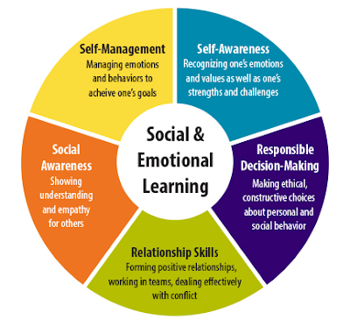
SSIS-SEL Pearson

Slide 24
DBT in Schools
Dialectical behavior therapy (DBT) skills have been demonstrated to be effective in helping adolescents manage difficult emotional situations, cope with stress, and make better decisions. DBT is an innovative social–emotional learning curriculum designed to be taught at the universal level in grades 6-12.
mindfulness, distress tolerance, emotion regulation, and interpersonal effectiveness—

Slide 25
DBT

Slide 26
SOS – Signs of suicide
Prevention Program including:
Video with real-life scenarios
Small group discussion w/ trained leader
Brief screen for depression

Slide 28
How we all can help our students:
Know them
Listen to them
Be aware
ACT

Slide 29
Dreams for Future
Expand to other schools
Continuation over the summer
Involve families more
Access to bilingual support

