Slide 1

School Mental Health System Development from the Ground Up: Early/Intermediate
3rd Annual Growing School Mental Health Summit
Madison, Wisconsin
June 22, 2018
Elizabeth Connors, PhD, Assistant Professor, University of Maryland, Baltimore, MD
Jenny Miller, NCC, LPC, Manager of School Based Mental Health Programs, Childrens Hospital of WI Community Services
Charles Bauernfeind, MSW, APSW, School Coordinator for the School Community Partnership for Mental Health, Milwaukee, WI
Notes:
Find out who is in the room

Slide 2

Launching your School Mental Health System
Current Status of the Field
Thinking Ahead About Quality and Sustainability
Practical Resources
Notes:
Thinking Ahead About Quality
National Performance Standards: School Mental Health Quality and Sustainability
“SHAPE”ing your System

Slide 3

RECAP: WHAT IS COMPREHENSIVE
SCHOOL MENTAL HEALTH?
Notes:
We are charged with advancing 'comprehensive school mental health'

Slide 4
What School Mental Health is NOT

Slide 5


A partnership between schools and community health and behavioral health organizations…
Guided by youth and families.
Notes:
When we speak of “school mental health”, we are not speaking of mental health that is owned and delivered solely by the education sector. Rather, we are speaking about a strategic partnership between schools and community health and behavioral health organizations, always guided by youth and families.

Slide 6

Partners build on existing
school programs,
services,
and strategies.
Notes:
Partners BUILD upon existing school programs, services, and strategies.

Slide 7

…in both general and special education
Focuses on all students…
Notes:
We emphasize ALL students, in both general and special education

Slide 8
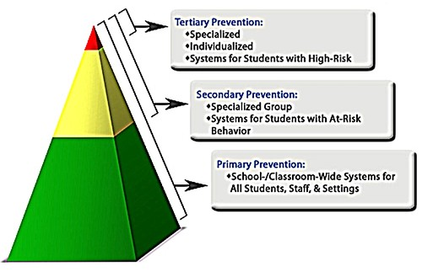
Includes a full array of programs, services, and strategies
Notes:
. And finally, school mental health is NOT just about serving students with the greatest mental health problems. Rather, we emphasize a full array of programs, services, and strategies – mental health education and promotion through intensive intervention.

Slide 9

Provides evidence-based practices and
Addresses quality improvement
Notes:
. And finally, school mental health is NOT just about serving students with the greatest mental health problems. Rather, we emphasize a full array of programs, services, and strategies – mental health education and promotion through intensive intervention.

Slide 10

WHY INVEST IN
SCHOOL MENTAL HEALTH?

Slide 11
Median Age of Onset: Mental Illness
Age 80
Substance Abuse
Later onset mostly secondary conditions
Opposition Defiant Disorder
Age 60
Intermittent Explosive Disorder
Major Depression
ADHD
Conduct Disorder
Psychosis
Age 40
Mid- 20s
Phobias & Separation Anxiety
Severe disorders preceded by less severe disorders (untreated)
Mid-teens
Autism Spectrum Disorders
Age 20
Birth
Source: WHO World Mental Health surveys as reported in Kessler et al. (2007)

Slide 12
In a given classroom of 25 students….
1 in 10 will experience a mental health problem of severe impairment
1 in 5 will experience a mental health problem of mild impairment
Less than half of those who need it will get services

Slide 13

Of those who DO receive services, over 75% receive those services in schools
(Duchnowski, Kutash, & Friedman, 2002; Power, Eiraldi, Clarke, Mazzuca & Krain, 2005; Rones & Hoagwood, 2000; Wade, Mansour, & Guo, 2008)
Notes:
What many are not aware of, however, is that of those who DO receive services, over 75% of youth receive those services in schools.

Slide 14

Advantages of the School Setting
  Greater access to all youth → mental health promotion/prevention
  Less time lost from school and work
  Greater generalizability of interventions to
  child’s context
  Less threatening environment
    Students are in their own social context
  Clinical efficiency and productivity
  Outreach to youth with internalizing problems
  Cost effective
  Greater potential to impact the learning environment and educational outcomes

Slide 15

Research Demonstrates Positive Outcomes of School Mental Health Services
Improvements in social competency, behavioral and emotional functioning
Improvements in academics (GPA, test scores, attendance, teacher retention)
Cost savings!
Increased access to care → Decreased health disparities
(Greenberg et al., 2005; Greenberg et al., 2003; Welsh et al., 2001; Zins et al., 2004; Bruns et al., 2004; Lehr et al., 2004; Jennings, Pearson, & Harris, 2000; Hoagwood, Olin, Kerker, Kratochwill, Crowe, & Saka, 2007; Wilson & Lipsey, 2007)

Slide 16

Kase, C., Hoover, S. A., Boyd, G., Dubenitz, J., Trivedi, P., Peterson, H., & Stein, B. (2017). Educational outcomes associated with school behavioral health interventions: A Review of the Literature. Journal of School Health, 87(7), 554-562.
Findings from 36 primary research, review, and meta-analysis articles
2000-2017
Benefits of school behavioral health clinical interventions and targeted interventions on a range of academic outcomes for adolescents.

Slide 17

What’s happening on the front lines of school mental health?

Slide 18
Successes
Increasing emphasis on:
  Multi-tiered Systems of Support (RtI, PBIS-SMH/ISF, etc)
  Evidence-based (research-supported) Practice (EBP)
  Consideration of cultural context in development, implementation, and evaluation of EBP
  Meaningful partnership with families
  School-community partnerships
  Workforce training for mental health providers and educators
  Outcomes
Pockets of funding to support school mental health
  Increased federal investments
  Creative funding streams at local/state levels

Slide 19

Challenges
Limited, variable funding
Limited system integration (Mental Health-Education)
Poor practice selection
Gaps in training, particularly related to working schools, engaging families, evidence-based practice
“C.O.W. Therapy” – Crisis of the Week
Poor implementation support
Limited control/accountability of providers and services provided
Lack of good data metrics and infrastructure

Slide 20
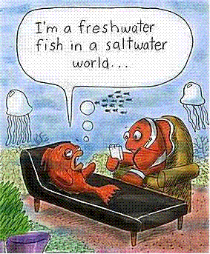
We’ve have achieved success!
We are “seeing” Javier for 60 minutes each week.
Notes:
We’ve got a system that is built around deliverables and productivity – We’ve got this under control – We are “seeing Johnny for 60 minutes each week”.
I will never forget my first experience providing mental health services in schools. I was still in graduate school, and was working extra hours for an outpatient mental health clinic that had a contract with some schools who had fallen behind on their special education behavioral health support services. I was given a list of students, and told that I should “see” them for a certain amount of time each per week. Johnny 30 minutes per week, Suzie 60 minutes per week, etc. I was distressed at having little to no data on which to base interventions, and being much more compliant than I am now, I went along with the system. However, I can’t help but think back and wonder what a disservice was done to those kids, and what a waste of resources it may be to just “see” kids with our only measure of success being the number of minutes we spent together.

Slide 21
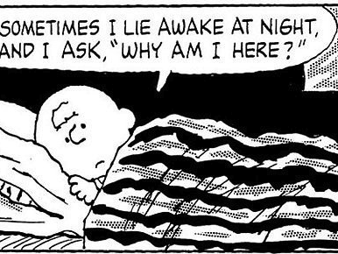
Charlie is doing fine because he has no discipline referrals.
Notes:
Also concerning is the fact that many schools, even those successfully implementing multi-tiered systems of behavioral supports, are missing some serious mental health problems among youth, particularly those youth with internalizing disorders that may go undetected with our systems of behavior monitoring.

Slide 22

What implementation often feels like (without proper planning)…

Slide 23
Thinking ahead about quality and sustainability

Slide 24
We need
STANDARDS,
PROCESSES,
and
STRATEGIES
for integrating
mental health into education

Slide 25




Slide 26
4-Stage Performance Measure Development
Phase 1: Expert consensus
Phase 2: Project advisor nominal group decision-making
Phase 3: School mental health stakeholder modified Delphi process
Phase 4: Revision via feedback from Cohort 1 CoIIN sites
Connors, Stephan, Lever, Ereshefsky, Mosby, & Bohnenkamp, 2015

Slide 27
Elements of School Mental Health Quality
_________________________________
  Teaming
  Needs Assessment / Resource
  Mapping
  Screening
  Evidence-Based Services and
  Supports
  Evidence-Based Implementation
  Data-Driven Decision Making

Slide 28
Elements of School Mental Health Sustainability
__________________________________
    Funding and Resources
    Resource Utilization
    Quality
    Documentation and Reporting Impact
    Marketing and Promotion

Slide 29


Slide 30
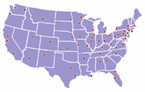
Schools and School Districts Can Use SHAPE To:
Document your service array and multi-tiered services and supports
www.theshapesystem.com

Slide 31
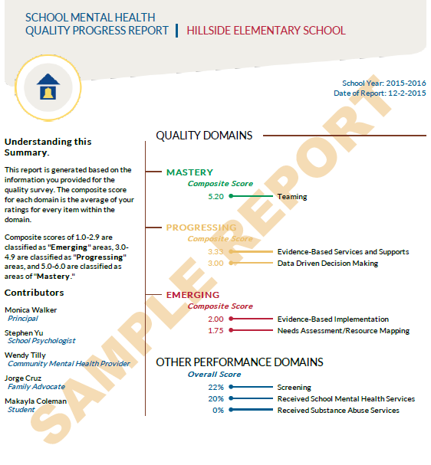
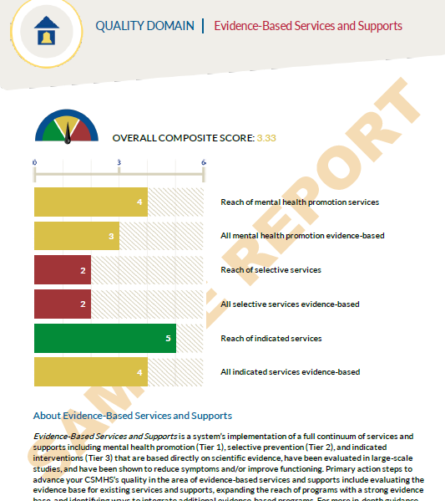
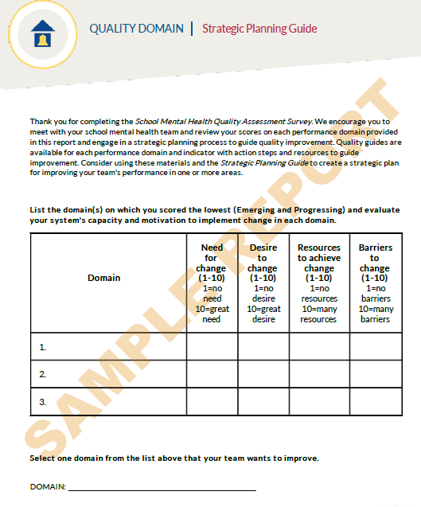
Schools and School Districts Can Use SHAPE To:
Advance a data-driven mental health team process for the school or district
  Strategic Team Planning
  Free Custom Reports
www.theshapesystem.com

Slide 32
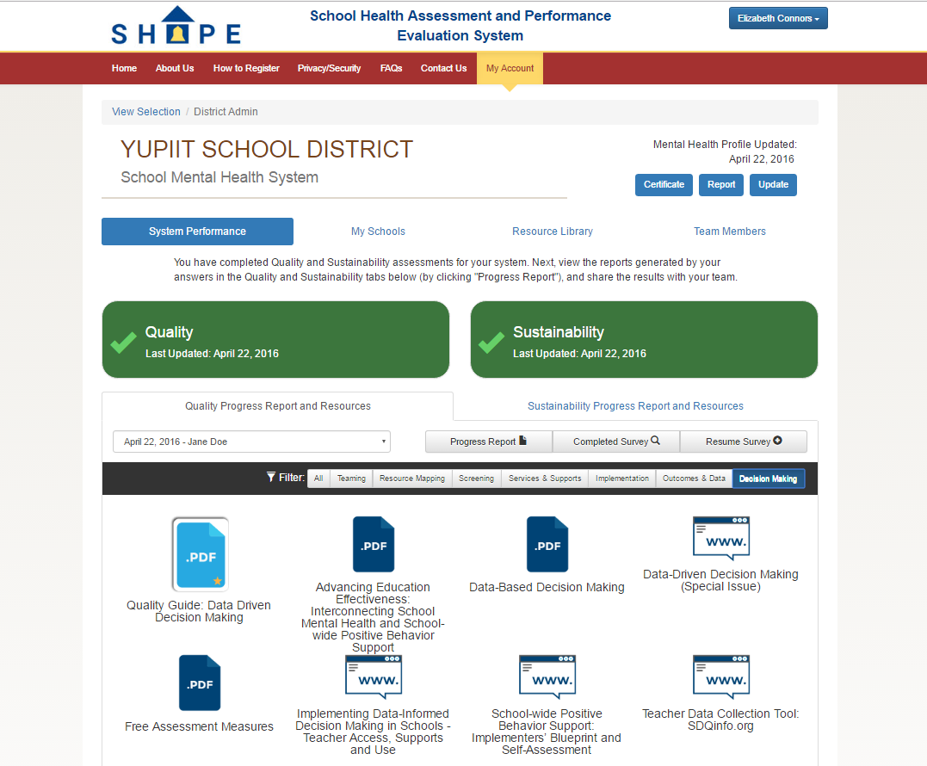
Schools and School Districts Can Use SHAPE To:
Access targeted resources to help advance your school mental health quality and sustainability

Slide 33
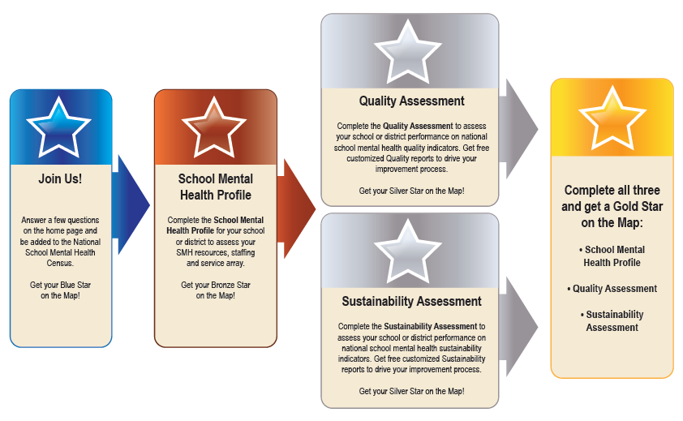

Schools and School Districts Can Use SHAPE To:
Achieve SHAPE Recognition to increase opportunities for federal, state and local funding

Slide 34
New Features of SHAPE
SHAPE - Trauma-Responsive Schools (TRS)
Co-developed by the NCTSN, Treatment and Services Adaptation Center for Resiliency, Hope and Wellness in Schools (www.traumaawareschools.org) and CSMH (http://csmh.umaryland.edu)
Domains:
School-wide Safety (e.g., predictable routines, physical safety)
School-wide Programming (e.g., restorative justice, culturally responsive teaching)
Staff Trauma Knowledge (e.g., school/classroom impact of trauma, neurological impact)
Staff Trauma Skills (e.g., trauma-informed communication, de-escalation)
Early Intervention Activities (e.g., trauma screening, early intervention evidence-based trauma practices)
Targeted Intervention Activities (e.g., School-based Trauma Treatments, Referrals)
Staff Wellness/Burnout/Secondary Traumatic Stress (e.g., Staff Assessment, Staff Supports)
All items are on a 6-point Likert scale reflecting degree of implementation

Slide 35
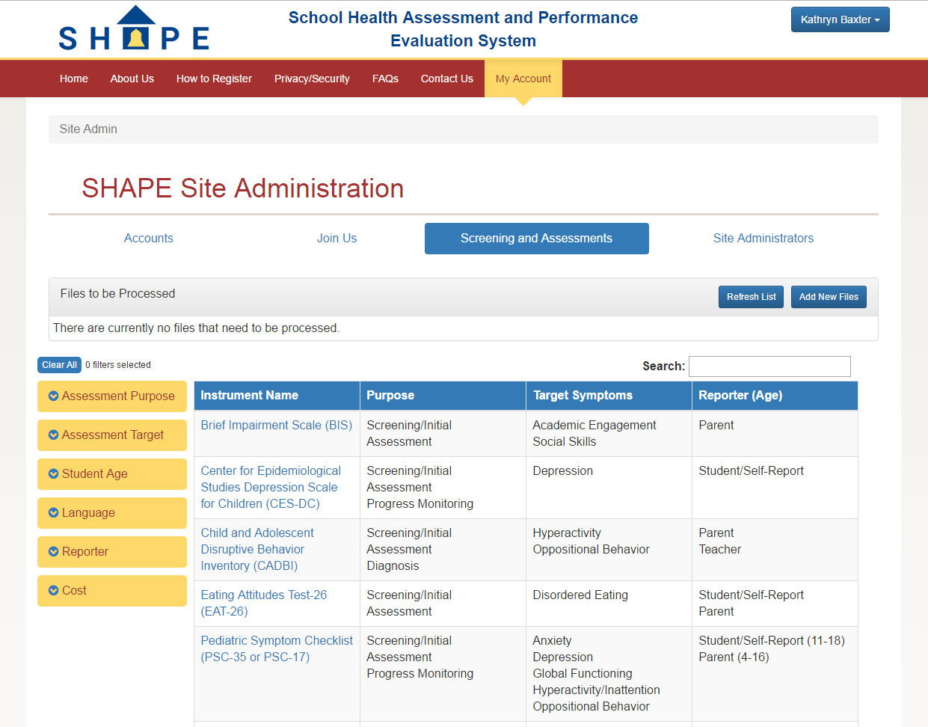

Slide 36
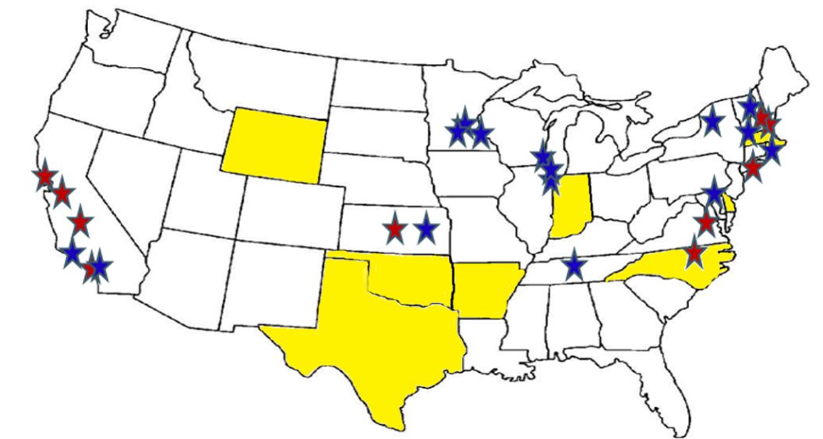

Schools and Districts Using SHAPE
State Teams:
Arkansas
Connecticut
Delaware
Indiana
Massachusetts
New Hampshire
New York City
North Carolina
Oklahoma
Rhode Island
Texas (Houston)
Washington
Wisconsin
Wyoming
Schools and districts in 49 states + Washington DC completed the School Mental Health Census and using SHAPE
COHORT I
(October 2015-December 2016)
7 Quality CoIIN Teams:
Baltimore City Public Schools, Baltimore, MD
Chicago Public Schools, Chicago, IL
MH Center of East Central Kansas, Emporia, KS
Metropolitan Nashville Public Schools, Nashville, TN
Minneapolis Public Schools, Minneapolis, MN
Proviso East High School, Maywood, IL
Racine Unified School District, Racine, WI
5 Sustainability CoIIN Teams:
Lindsay Unified School District, Lindsay, CA
Methuen Public Schools, Methuen, Massachusetts
Newport-Mesa Unified Schools, Costa Mesa, CA
Novato Unified School District, Novato, CA
Stamford Public Schools, Stamford, CT
COHORT II
(September 2016-November 2017)
8 Quality CoIIN Teams:
Anaheim Union High School District, Orange County, CA
Fairport Central School District, Rochester, NY
New Richland Hartland Ellendale Geneva, Southern, MN
Newport School District, Newport, NH
Pelham School District, Manchester, NH
Providence Public School District, Providence, RI
Santa Monica/Malibu Unified School District, SM/M, CA
Winona Area Public Schools, Winona, MN
5 Quality Plus Sustainability CoIIN Teams:
Chapel Hill Carrboro City Schools, Chapel Hill, NC
District of Columbia Public Schools, Washington, DC
Mental Health Center of East Central Kansas, Emporia, KS
Oakland Unified/Seneca Family of Agencies, Oakland, CA
SAU #7, Colebrook, Pittsburg, & Stewartstown, NH
Notes:
Schools and districts in 49 states + Washington DC have started using SHAPE and completed the School Mental Health Census
The list of school districts you see on the right hand side are the 24 districts who are participating in our school mental health learning collaborative. They use SHAPE every month for 15 monthgs to track their quality and sustainability improvements and join us on monthly calls for ongoing technical assistance and peer learning to advance school mental health in their district..

Slide 37
Practical Resources

Slide 38


Slide 39


Slide 40
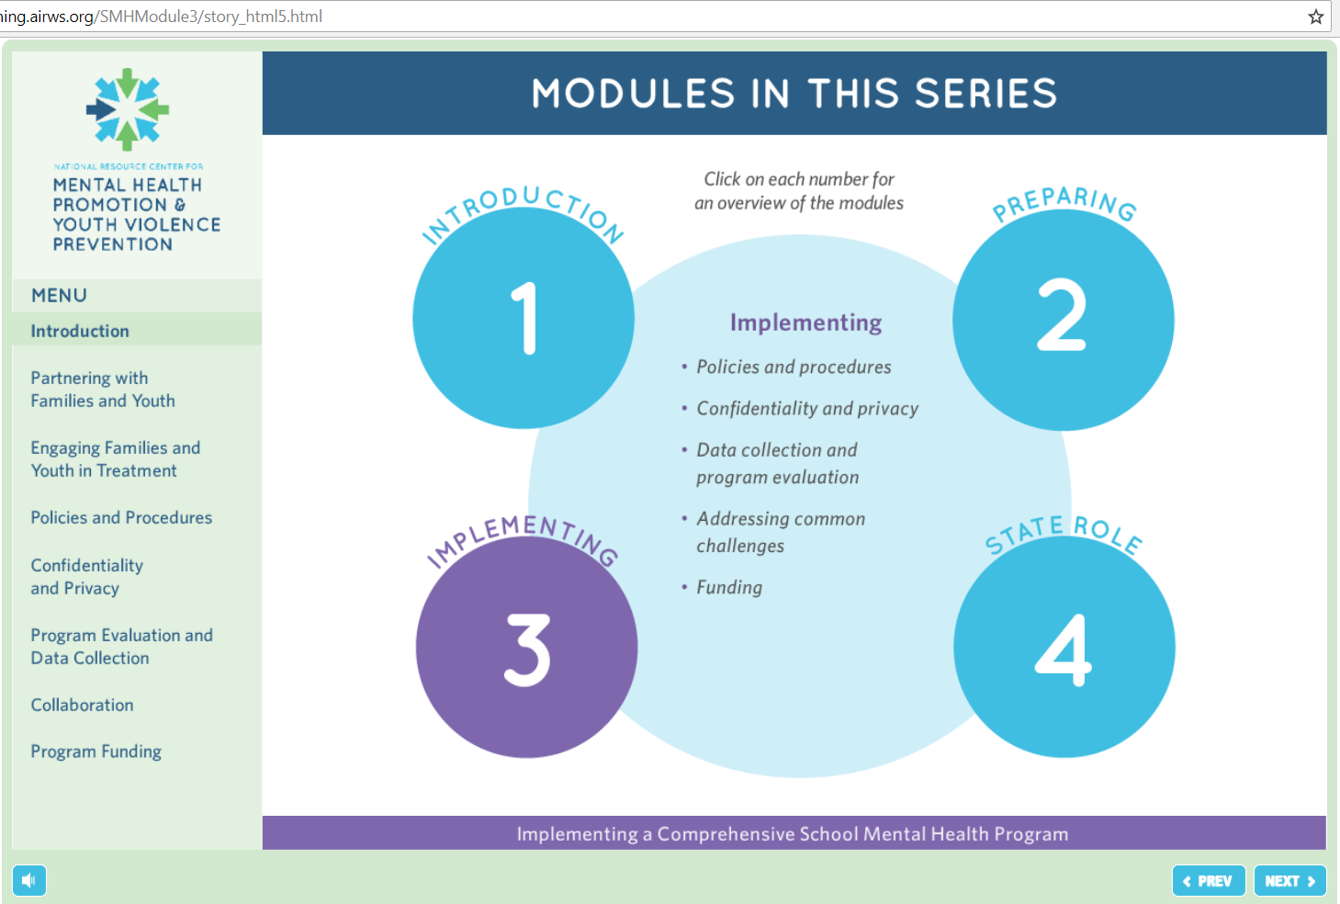

Slide 41
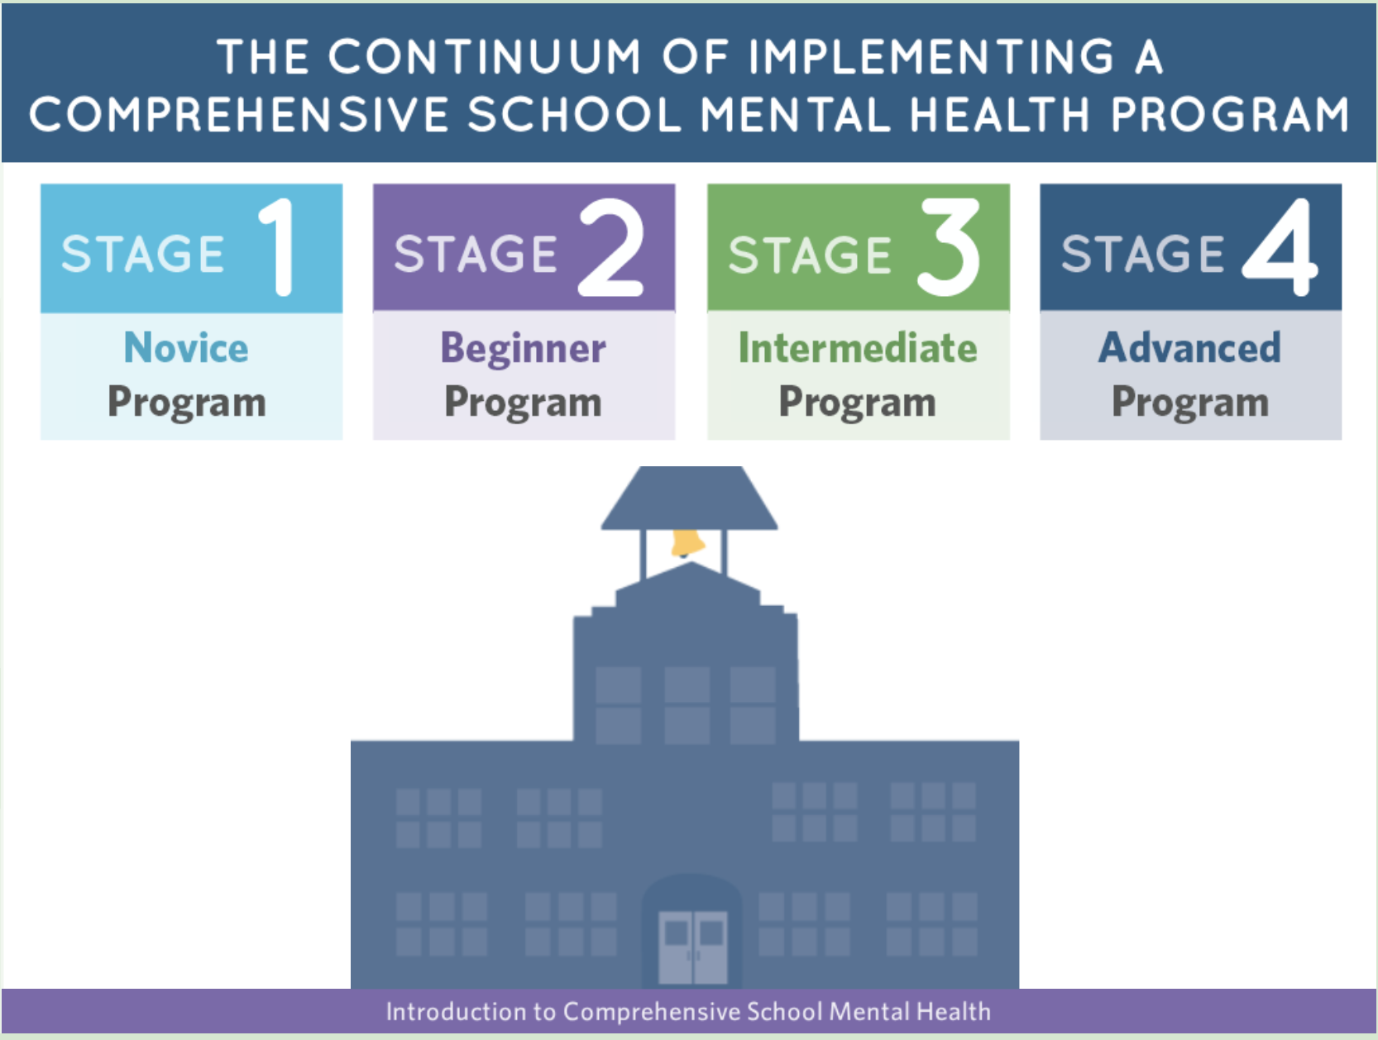
Notes:
http://airhsdlearning.airws.org/smhmodule1/story_html5.html
https://healthysafechildren.org/learning-module-series/mental-health-module-series

Slide 42
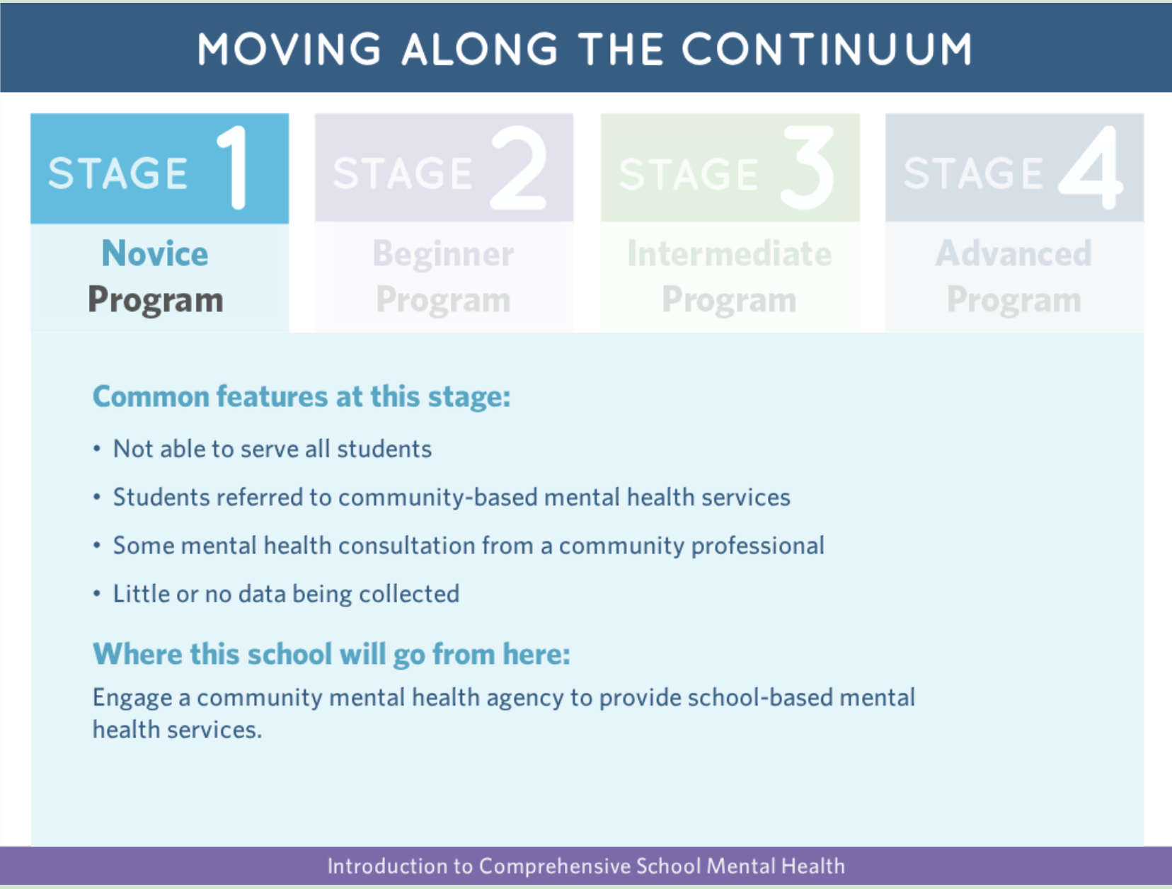

Slide 43
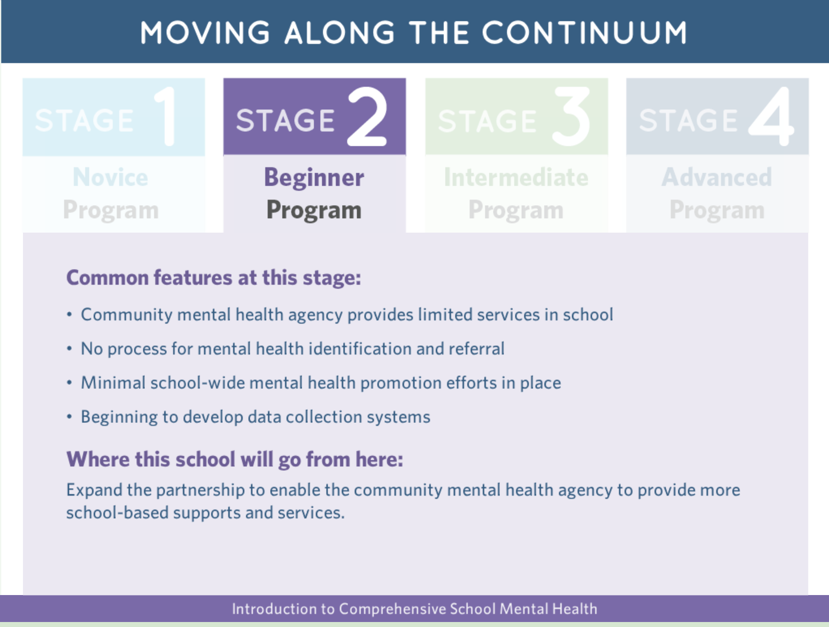

Slide 44
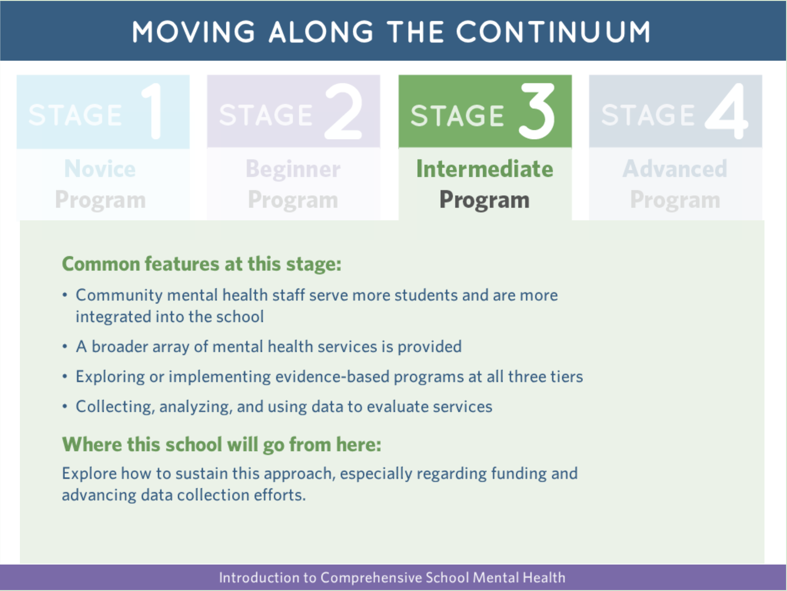

Slide 45
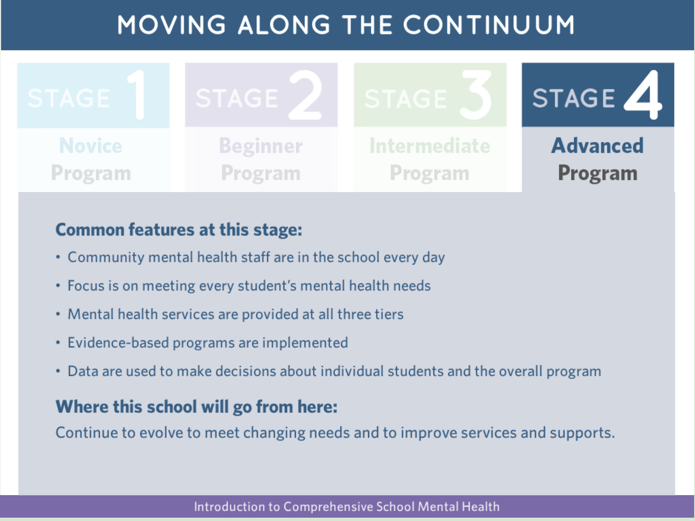
http://airhsdlearning.airws.org/smhmodule1/story_html5.html
https://healthysafechildren.org/learning-module-series/mental-health-module-series

Slide 46


Slide 47
The Community-Partnered School Behavioral Health modules
Free Training Series and CEUs Offered at
www.mdbehavioralhealth.com
Community-Partnered School Behavioral Health Implementation Modules provides a range of strategies, resources, and tools necessary to establish, maintain, and expand effective student behavioral health programs. These modules focus specifically on supporting student social, emotional, behavioral and academic progress via a community-partnered approach to school behavioral health.
MODULE 1: Community-Partnered School Behavioral Health: An Overview
MODULE 2: Operations: An Overview of Policies, Practices, and Procedures
MODULE 3: Overview of School Language and Policy
MODULE 4: Funding Community-Partnered School Behavioral Health
MODULE 5: Resource Mapping
MODULE 6: Teaming
MODULE 7: Evidence-Based Practices and Programs: Identifying and Selecting EBPs
MODULE 8: Implementation Science: Lessons for School Behavioral Health
MODULE 9: Data Informed Decision Making
MODULE 10: School Behavioral Health Teacher Consultation
MODULE 11: Psychiatry in Schools
MODULE 12: Starting Early: Supporting Social Emotional Development and School Readiness
MODULE 13: School Behavioral Health Program Evaluation 101
MODULE 14: Ten Critical Factors to Advance State and District School Behavioral Health Objectives
MODULE 15: Working with State Leaders to Scale-Up School Behavioral Health Programming in Your State
Published by the Center for School Mental Health, Baltimore, Maryland 2015
Permission is given to duplicate this document for professional use, as long as it is unaltered and complete.
This document should be cited as Center for School Mental Health (2015). Community Partnered Behavioral Health Implementation Modules.
Retrieved from www.MDBehavioralHealth.com
Notes:
This is one of many series of trainings available on mdbehavioralhealth.com specifically relevant to this audience, community-partnered school behavioral health implementation modules, but there are many others

Slide 48
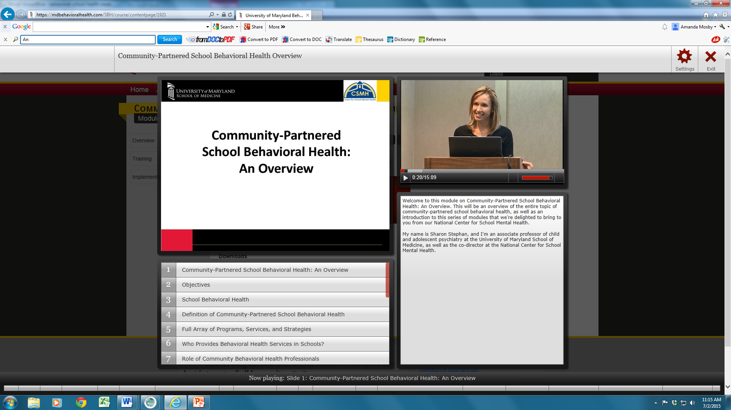
Notes:
We developed self-paced online learning modules which can be found on mdbehavioralhealth.com, which is a publicly accessable site available nationwide. Continuing education units are offered, and the materials are developed with adult learning in mind

Slide 49
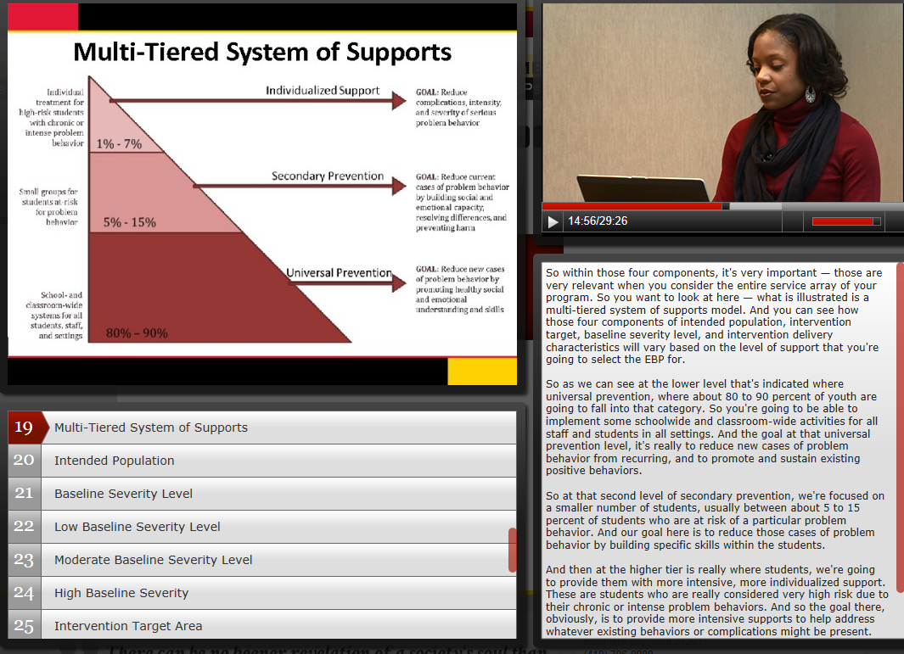
Notes:
Here are some screen shot examples of what is available

Slide 50
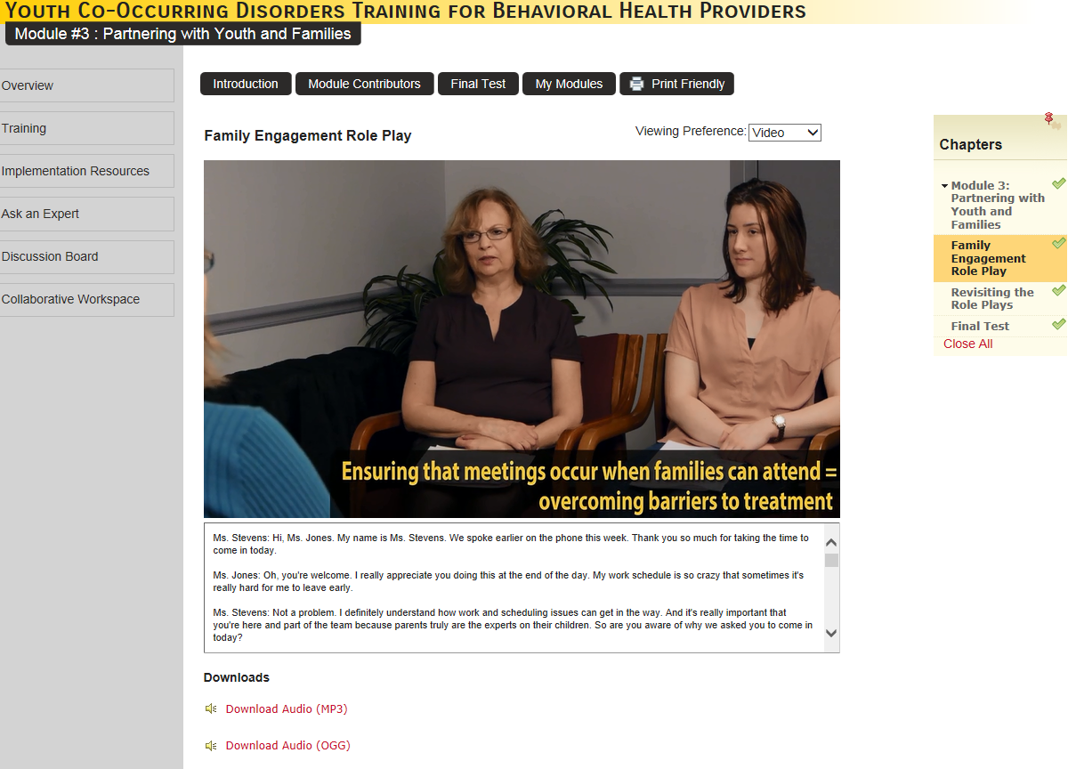
Notes:
This is a screenshot of a skills demonstration from the family engagement module. Some of the role plays include real clients in recovery and are very powerful and informative.

Slide 51


School Mental Health Playbooks and Webinar Series
http://csmh.umaryland.edu/Resources/BriefsReportsWhite-Papers/
Notes:
Photos of screening and teaming playbooks
We are so pleased to share with you all today our SMH Teaming Playbook today – as the second in a series of Playbook guides from the Center for School Mental Health that succinctly reviews best practices and tips from the field.
Before we move on – why have we chosen the term “playbook?”
This will resonate for those who love a sports metaphor –
It has been described this way -- “Successful football coaches can relay the fundamental knowledge of the game to their players in a clear and concise manner. Simplified instructional communication begins with designing playbooks for the offense, defense, and special teams that provide players detailed play diagrams accompanied by easily understandable text to explain all position assignments.”-
Playbooks are built on lessons learned from the field in sports, just as they are for our school mental health Playbooks.

Slide 52
Form Templates
When to Refer a Student
Referral Form Examples
Consent for Treatment Form
Release of Information Forms (to/from school; to/from other)
CSMHS Policies and Procedures Checklist
Memorandum of Understanding templates
Sample Student Referral, Crisis Flowchart, MH Staffing document
Referral Feedback Form
School wish list for community partner
SMH Referral and Triage Flowcharts

Slide 53


Slide 54

Break down your improvement goals into smaller tests of change

Slide 56
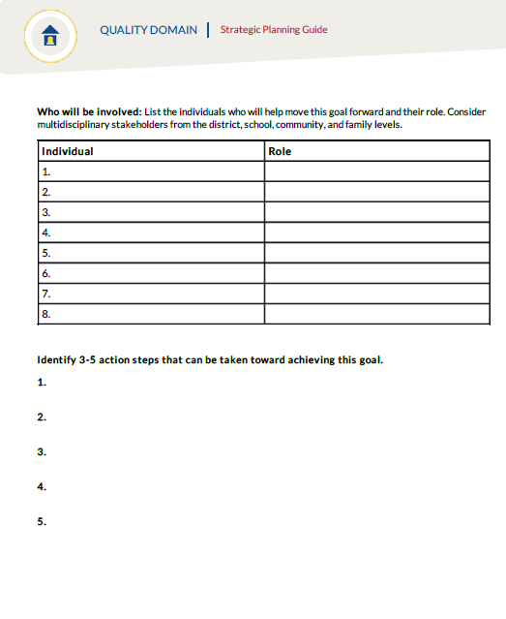

Slide 57
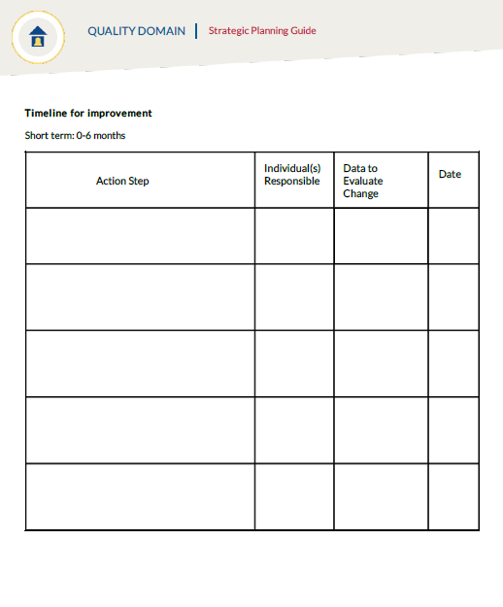

Slide 59
Take Home Points
Notes:
Thinking Ahead About Quality
National Performance Standards: School Mental Health Quality and Sustainability
“SHAPE”ing your System

Slide 60

Take Small Steps

Slide 61

Assess and Prioritize Your Goals

Slide 62

Don’t Go it Alone:
School Mental Health is a Team Sport!
Notes:
NANCY
(also shows not working on a team)

Slide 63


Comments/Questions?
Center for School Mental Health
http://csmh.umaryland.edu
Email: csmh@psych.umaryland.edu
Phone: (410) 706-0980
@CtrSchoolMH
Elizabeth Connors, Ph.D.
econnors@som.umaryland.edu
Phone: (410) 706-1456

